Slide 1
Sans Souci & Copperhead Association Annual General Meeting
At the SSCA Schoolhouse and via Zoom
July 6th, 2024 `

Slide 2
Recognition
We acknowledge the land we are meeting on is the traditional territory of the Huron-Wendat and Anishinaabe peoples and that this region is now home to many First Nations and Metis peoples.

Slide 3
Welcome
INTRODUCTIONS
SPECIAL GUESTS

Slide 4
SSCA Annual General Meeting Agenda – July 6, 2024
Welcome & Opening Remarks – Glen Campbell
Constitution of Meeting – Michael Reddy
Approval of 2023 AGM Minutes
Treasurer’s Report – Al Stratton
Approval of New By-laws – Michael Reddy
Revitalization Campaign Update – Eric Armour
New Community Centre/Dock Plan Update - Glen Campbell
Committee Updates
Township of the Archipelago Update – Alice Barton & David Ashley
GBA Update - Rupert Kindersley
Approval of Board/Executive & Board Actions – Glen Campbell
Other Business
Adjournment

Slide 5
SSCA Annual General Meeting (AGM) Housekeeping
Motions and seconding
Voting on motions
Asking questions & answers
Chat disabled
Panelists
Dial-in participants: Attendance and voting record

Slide 6
Constitution of Meeting
Notice of AGM:
Posted on website calendar
Posted on website news
Notice of meeting e-mailed to members
Quorum (30 members)

Slide 7
Approval of 2023 AGM Minutes
Posted on SSCA website
Emailed to members in AGM Notice of Meeting
Any corrections?
Motion to approve 2023 AGM minutes

Slide 8
Treasurer’s Report Al Stratton, Treasurer

Slide 9
In 2023, our operating surplus (reserves contribution) was very strong at $37,224 Reserves are required to maintain our facilities and are not "profit" For 2024 and beyond, we expect slower reserves growth

Slide 10
SSCA reserves fund growth

Slide 11
Treasurer’s Report Al Stratton, Treasurer
Motion to approve 2023 financial statements
Notes:
FOR 2023 AGM,. WE SHOULD TOUCH ON 1) PLAN TO SET ASIDE $30K ANNUALLY FOR DOCKS AND BUILDINGS, 2) EXPECTED 2023 SURPLUS/SHORTFALL, KEY DIFFERENCES VS 2022 AND HOW BIG A SET-ASIDE WE EXPECT TO MAKE

Slide 12
FOCA membership
In 2023, SSCA joined the Federation of Ontario Cottage Associations (FOCA)
FOCA is the voice for 250,000+ waterfront property owners across 525 lake & road associations
SSCA benefits from lower insurance rates
Each SSCA member is a member of FOCA and can register to access information and benefits such as discounts on phone plans and cottage insurance
Please register to secure these benefits

Slide 13
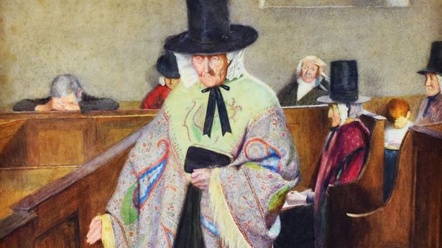
By-laws Update Michael Reddy, Secretary

Slide 14
By-laws Update Michael Reddy, Secretary
Ontario Not-For-Profit Corporations Act (ONCA)
New By-law #1 and #2
Governance Model : Articles, By-laws, Board Policies
`Biggest changes:
Board now 9-15 Directors not fixed at 15
3 year commitment on a Director joining the Board now contained in Board Policies not in By-laws
Directors must obtain Member approval to borrow money
Notes:
FOR 2023 AGM,. WE SHOULD TOUCH ON 1) PLAN TO SET ASIDE $30K ANNUALLY FOR DOCKS AND BUILDINGS, 2) EXPECTED 2023 SURPLUS/SHORTFALL, KEY DIFFERENCES VS 2022 AND HOW BIG A SET-ASIDE WE EXPECT TO MAKE

Slide 15
By-laws update
Motion to approve new SSCA by-laws

Slide 16
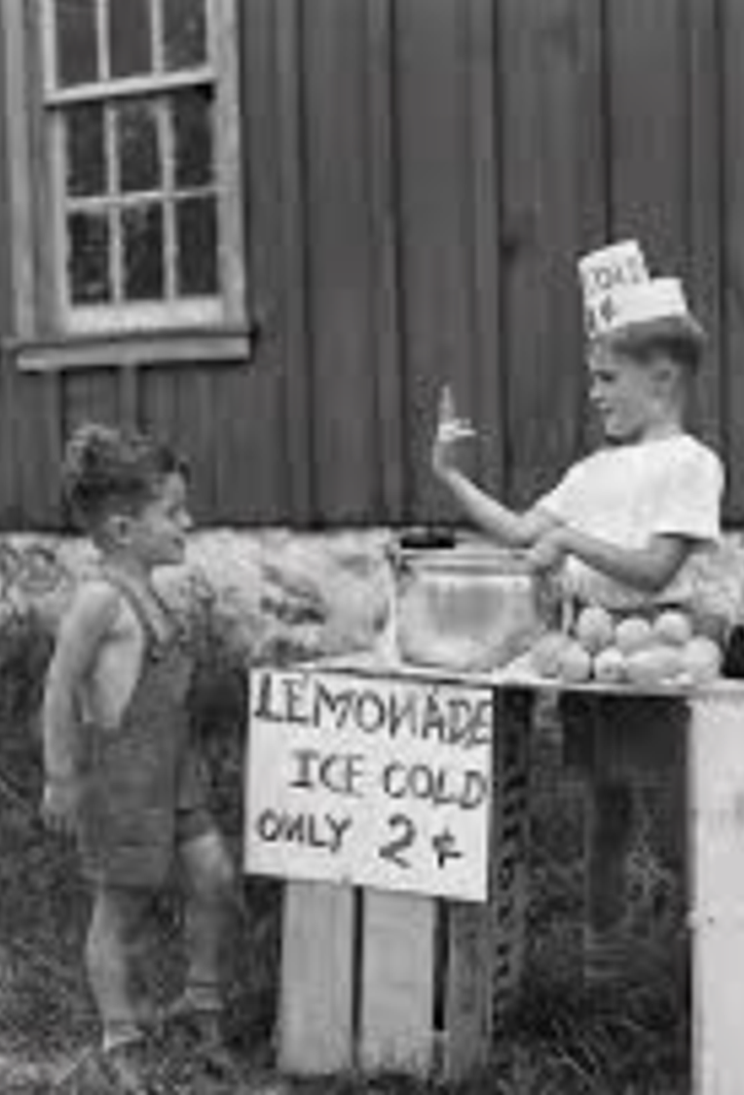
Revitalization Campaign Update Eric Armour
Campaign target: $2 million
Donations and pledges to date: $2.1 million, including $150K in directed donations (for fitness, kids' play zone)

Slide 17
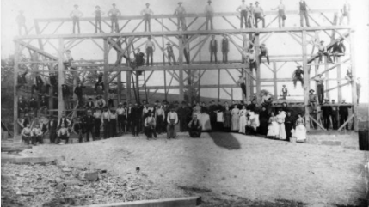
Community Centre project update Glen Campbell

Slide 18
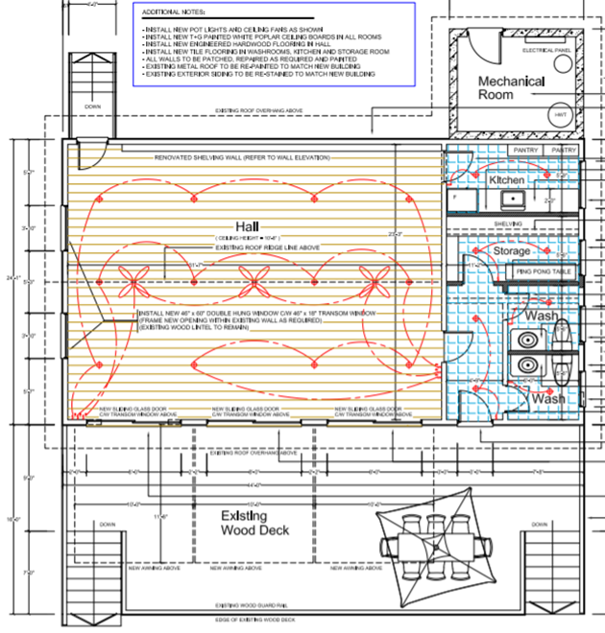
Revitalization Programme Recap
Schoolhouse renovation:
Completed May 2024 – on time!
Project design and management by Jackie Koza:
THANK-YOU JACKIE!
New building:
Site analysis completed
Modified building design being finalized for contractor quotes, construction in 2025

Slide 19
Site plan
Sloped walkway to deck built tight to rock (no railings, no steps). Steel-framed ramp base/ bridge two steps above cribs.
Deck, pavilion and building floors 5 feet above old deck (as required). Old decks to be removed.
New site plan eliminates costly rebuild of waterfront deck, with primary access now via south docks
Young kids play zone and play structure sited between new building and schoolhouse.

Slide 20
Revised building design keeps principal room sizes with less enclosed space, larger pavilion.

Slide 21
3D view

Slide 22
Dock plan: Approved for 2024-25 implementation
SSCA docks to be relocated to south cribs, with new ramp base, 25ft ramp and 2 new "spine" docks
Additional capacity: 4+ boats
(and 4+ overflow capacity on cribs)
Cost: $90K, with SSCA and SSTC making advance contributions to dock fund ($27K each)
Provides single point of access to property, avoids costly re-build of waterfront walkways and cribs

Slide 23
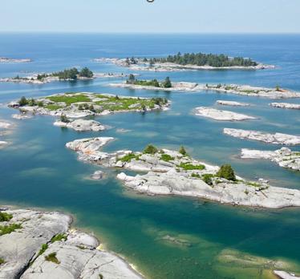
SSCA Committee Updates

Slide 24
Programs Tory Cadotte

Slide 25
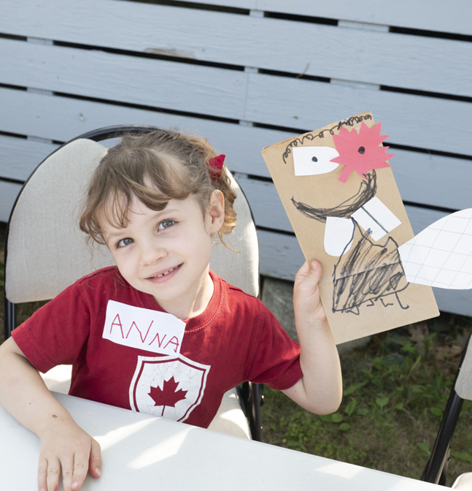
SSCA Programs Update
Day Camp
July 2 – August 16 (7 weeks), may offer one additional week Aug 19-23
Staff - Emma and Rachel
Implementing a parent feedback survey
Updated policies and best practices
Pricing adjustment $60/day, $250/week
Special guests – Jessica Vergeer (July 15), GBB (August 7)

Slide 26
SSCA Programs Update
Activities
Yoga (Trish Bolivar)
Basketball Practice (Jess Sloss & Peter Campbell)
Book Club (Cathie Singer)
Flashlight Reader Club (Carolyn Edwards)
*NEW Coffee & Kayak Paddle (LaRee Walters-Boadway)
Events
Volunteer Work Day (Rob Kennedy)
Canada Day Potluck (114+ attending, Performance by Michèle Pearson, Sponsor Dennis Hauck)
Painting Class with Jessica Vergeer
Sailing Camp (2 weeks, Glen Campbell)
Regatta/Art Show
Georgian Bay Biosphere Explore our Shore (Katherine Denune & GBB)
SSCA FUN-d-RAISER (Laura Hay)

Slide 27
Communications – Kirsi Henry

Slide 28
Membership - Jacquie Green

Slide 29
Environment Report
Katherine Denune

Slide 30
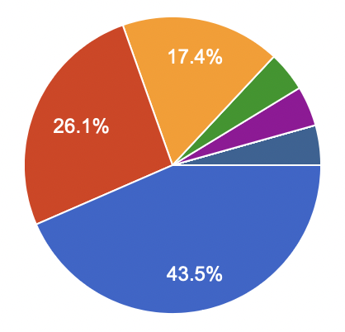
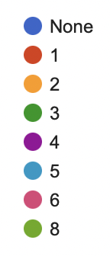
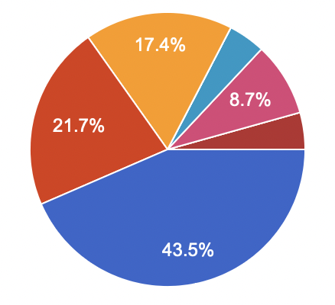
Bird and Bat House Initiative
# of Bird Houses
2023 Survey Results
23 Participants
Key Highlights
56% have at least one bird/bat house
17% have over five bat boxes on their property
One cottager has over 10 bird houses
30% don’t know what kind of bird house they have
# of Bat Boxes

Slide 31
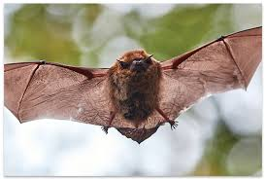
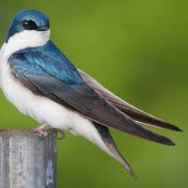
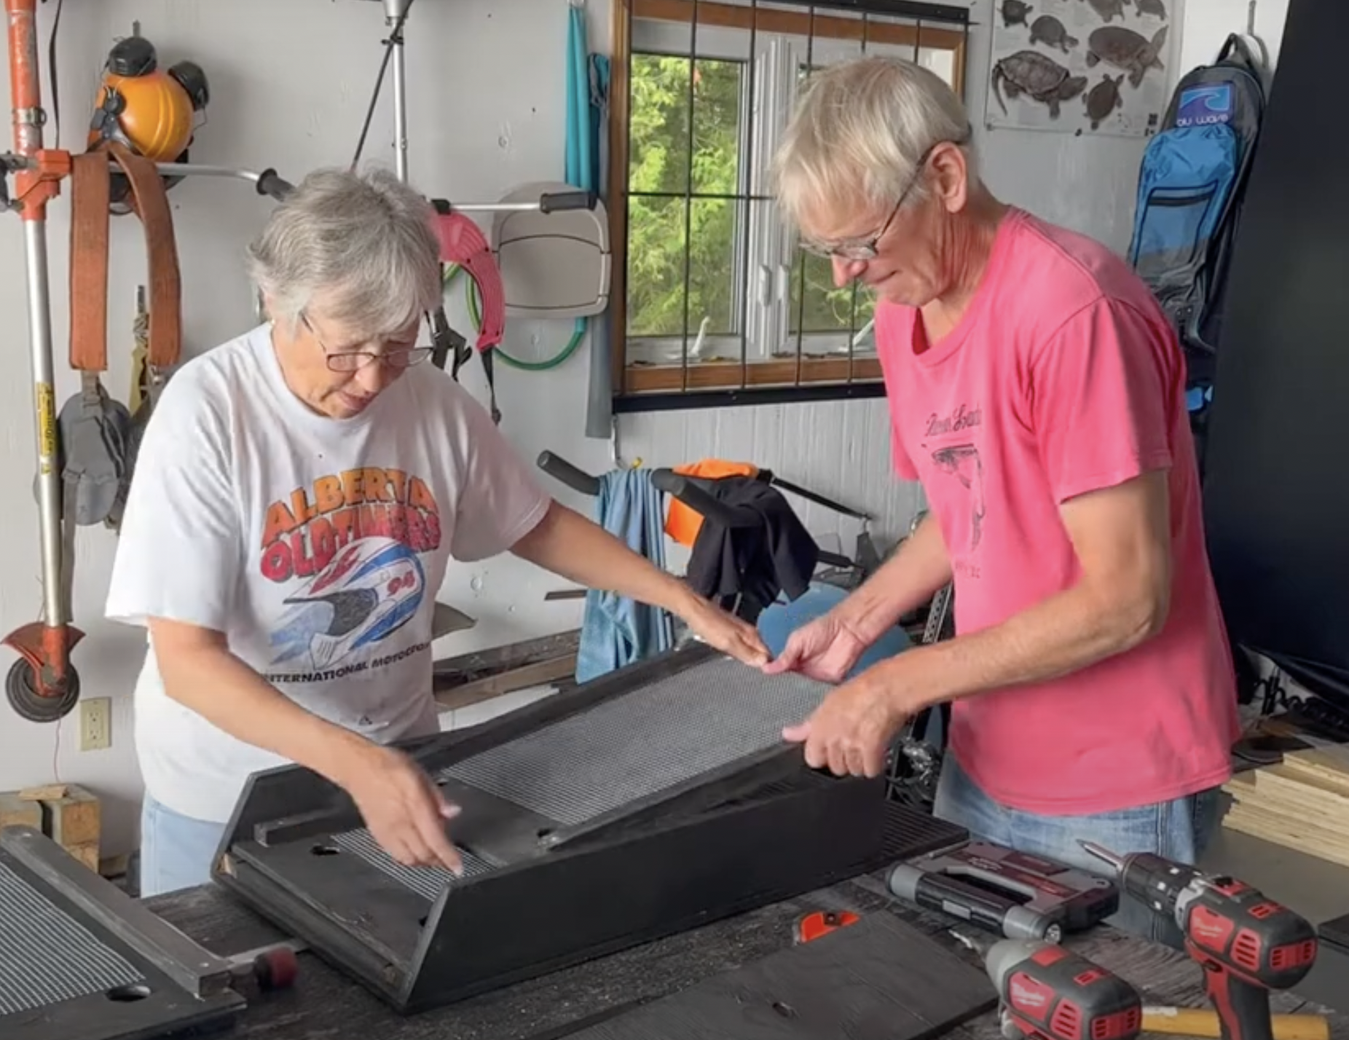
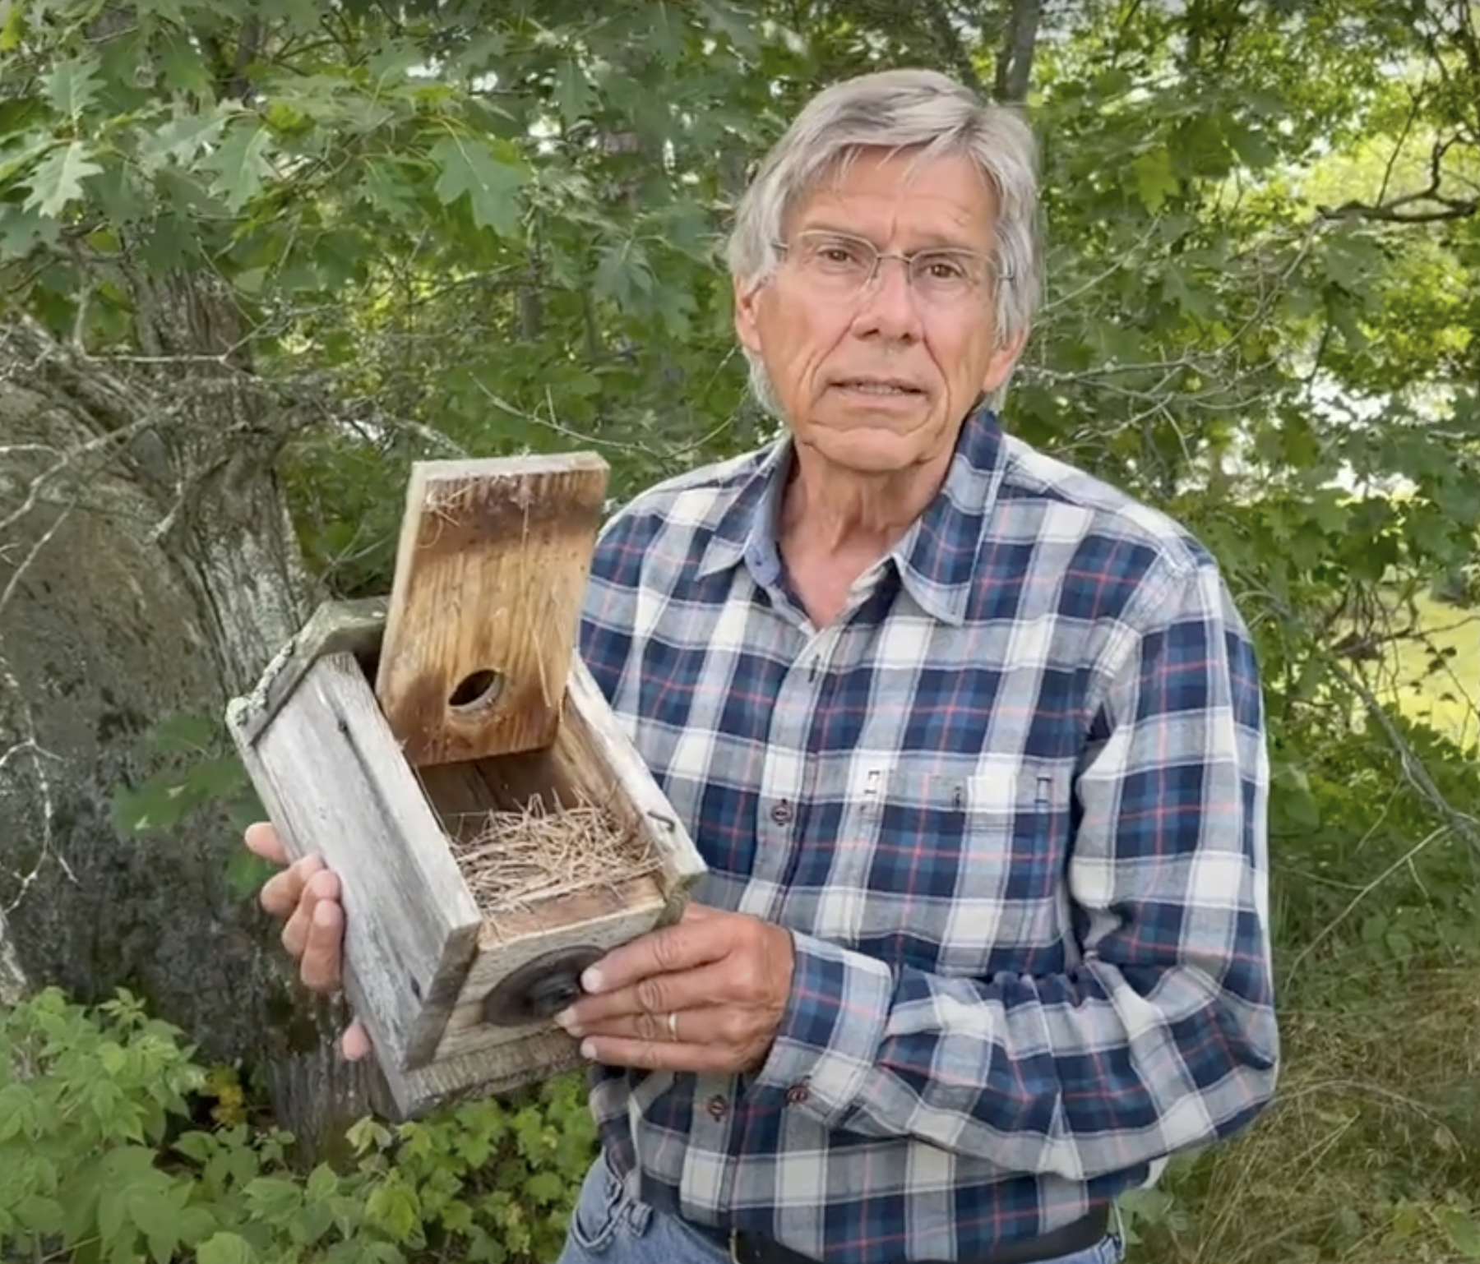
Bird and Bat House Initiative
Beth and Peter Adams building a bat house
Tom Denune with a tree swallow box

Slide 32
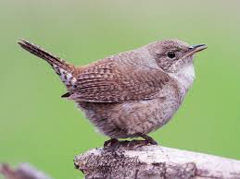
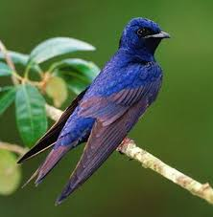
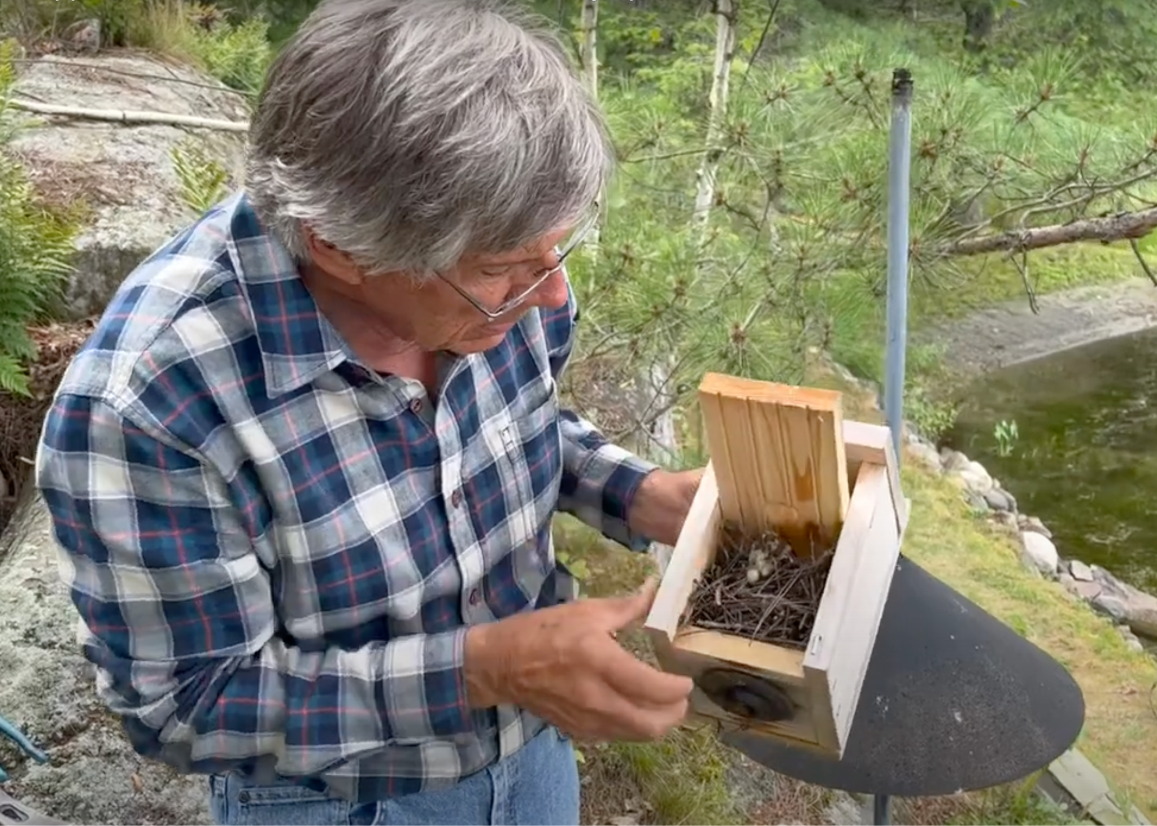
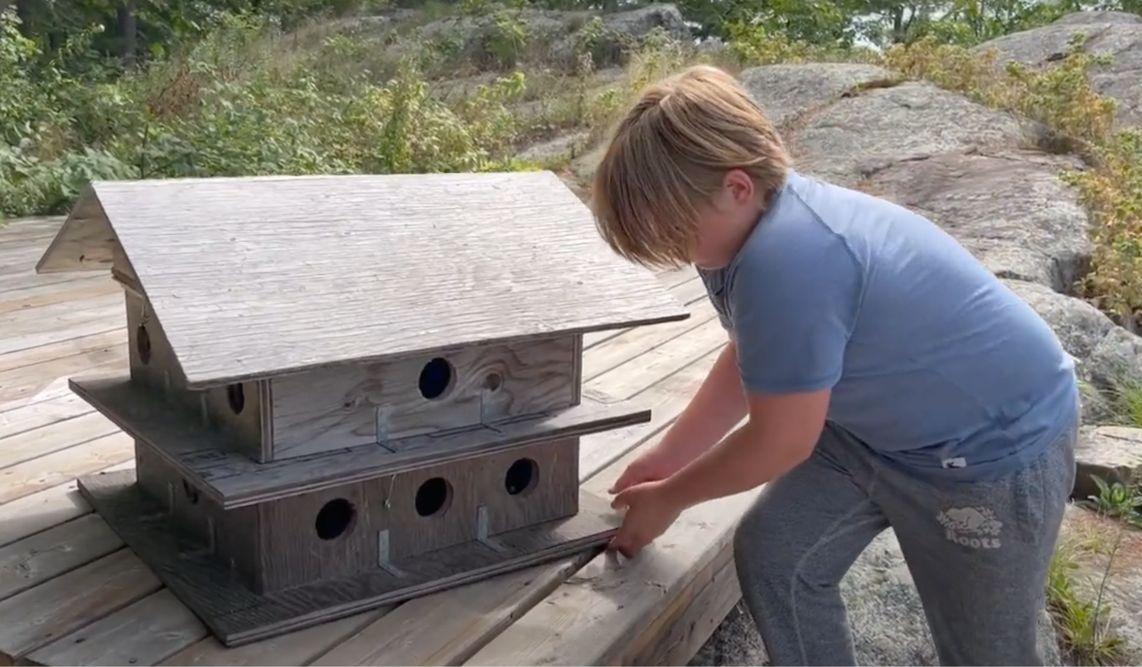
Bird and Bat House Initiative
Tom Denune with a house wren box
Fergus Michael with his new purple martin house

Slide 33
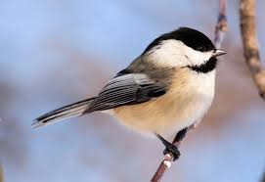
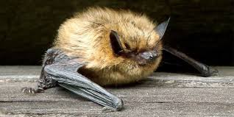
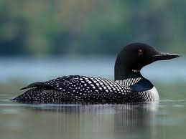
Next Steps
Begin a long term survey of successful species & nests
Increase the # of nest boxes in the SSCA
Provide information and education about specific species requirements

Slide 34
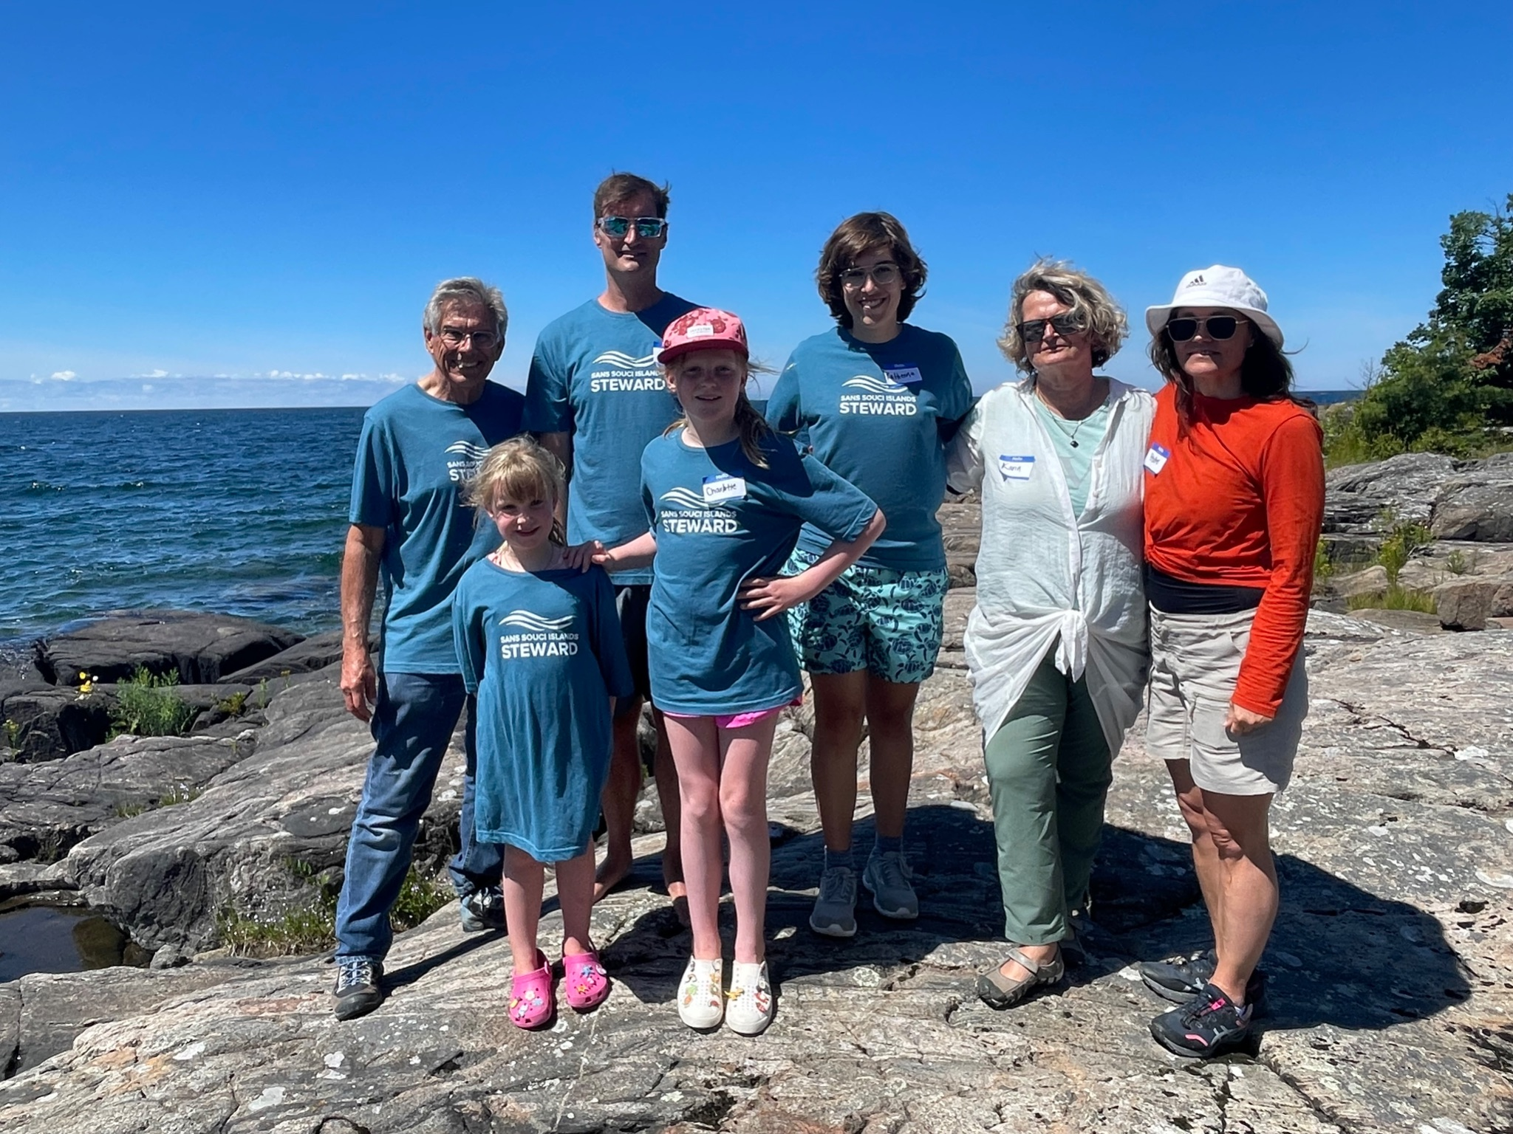
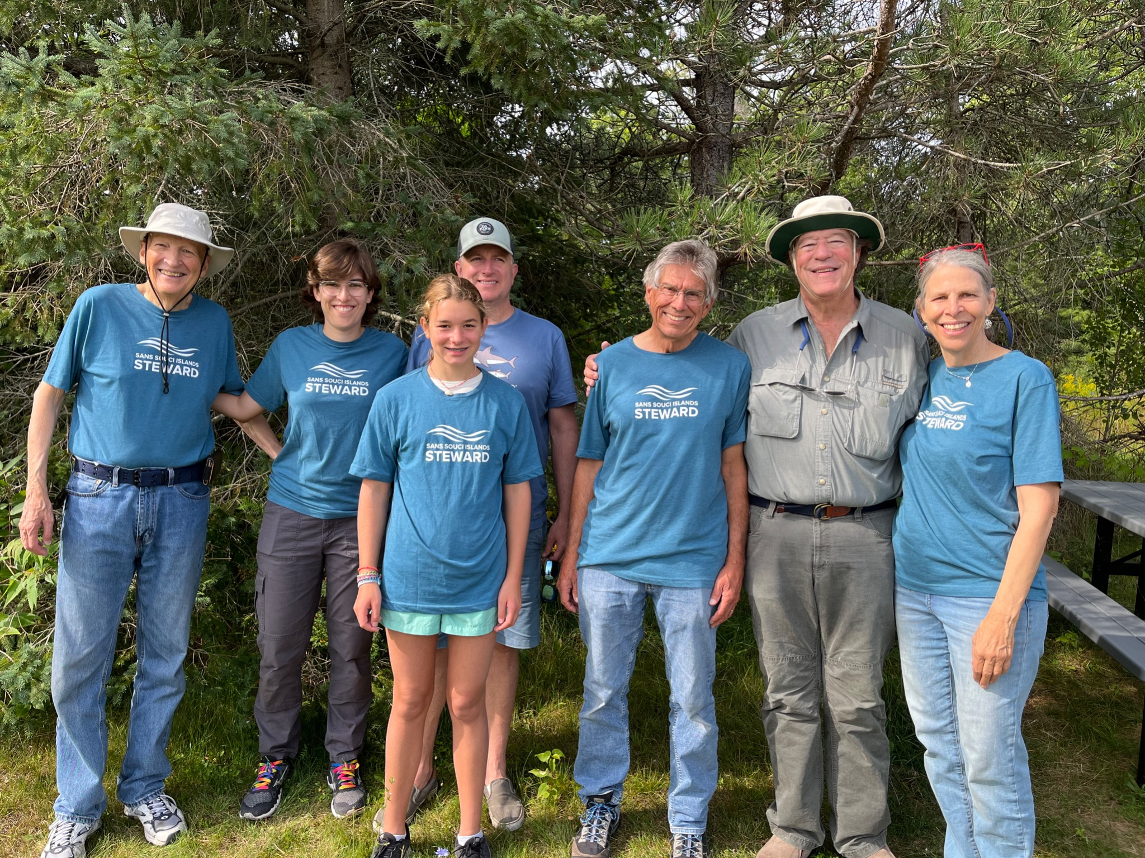
Sans Souci Island Stewards
Purpose
Begin a long term monitoring record of wildlife and human impacts on Pomeroy and Frying Pan Islands
Meet friends and neighbors interested in conservation
Active stewardship

Slide 35
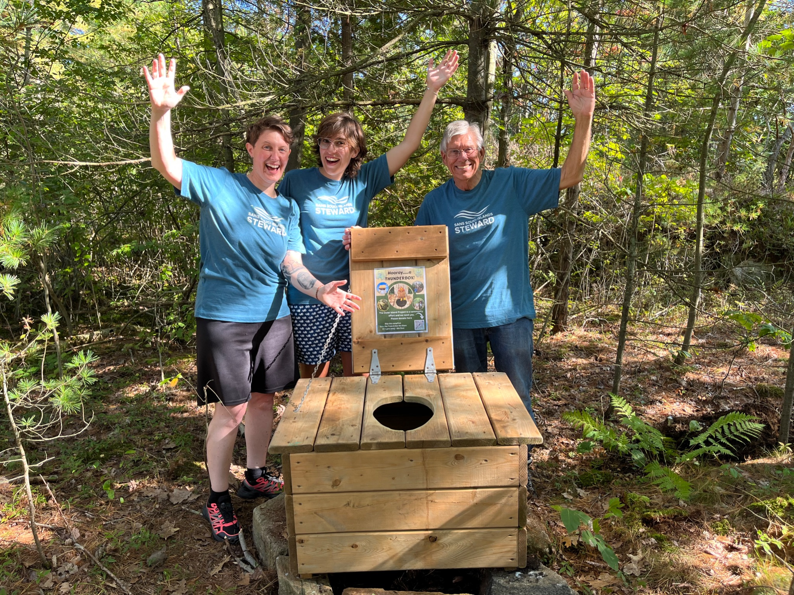
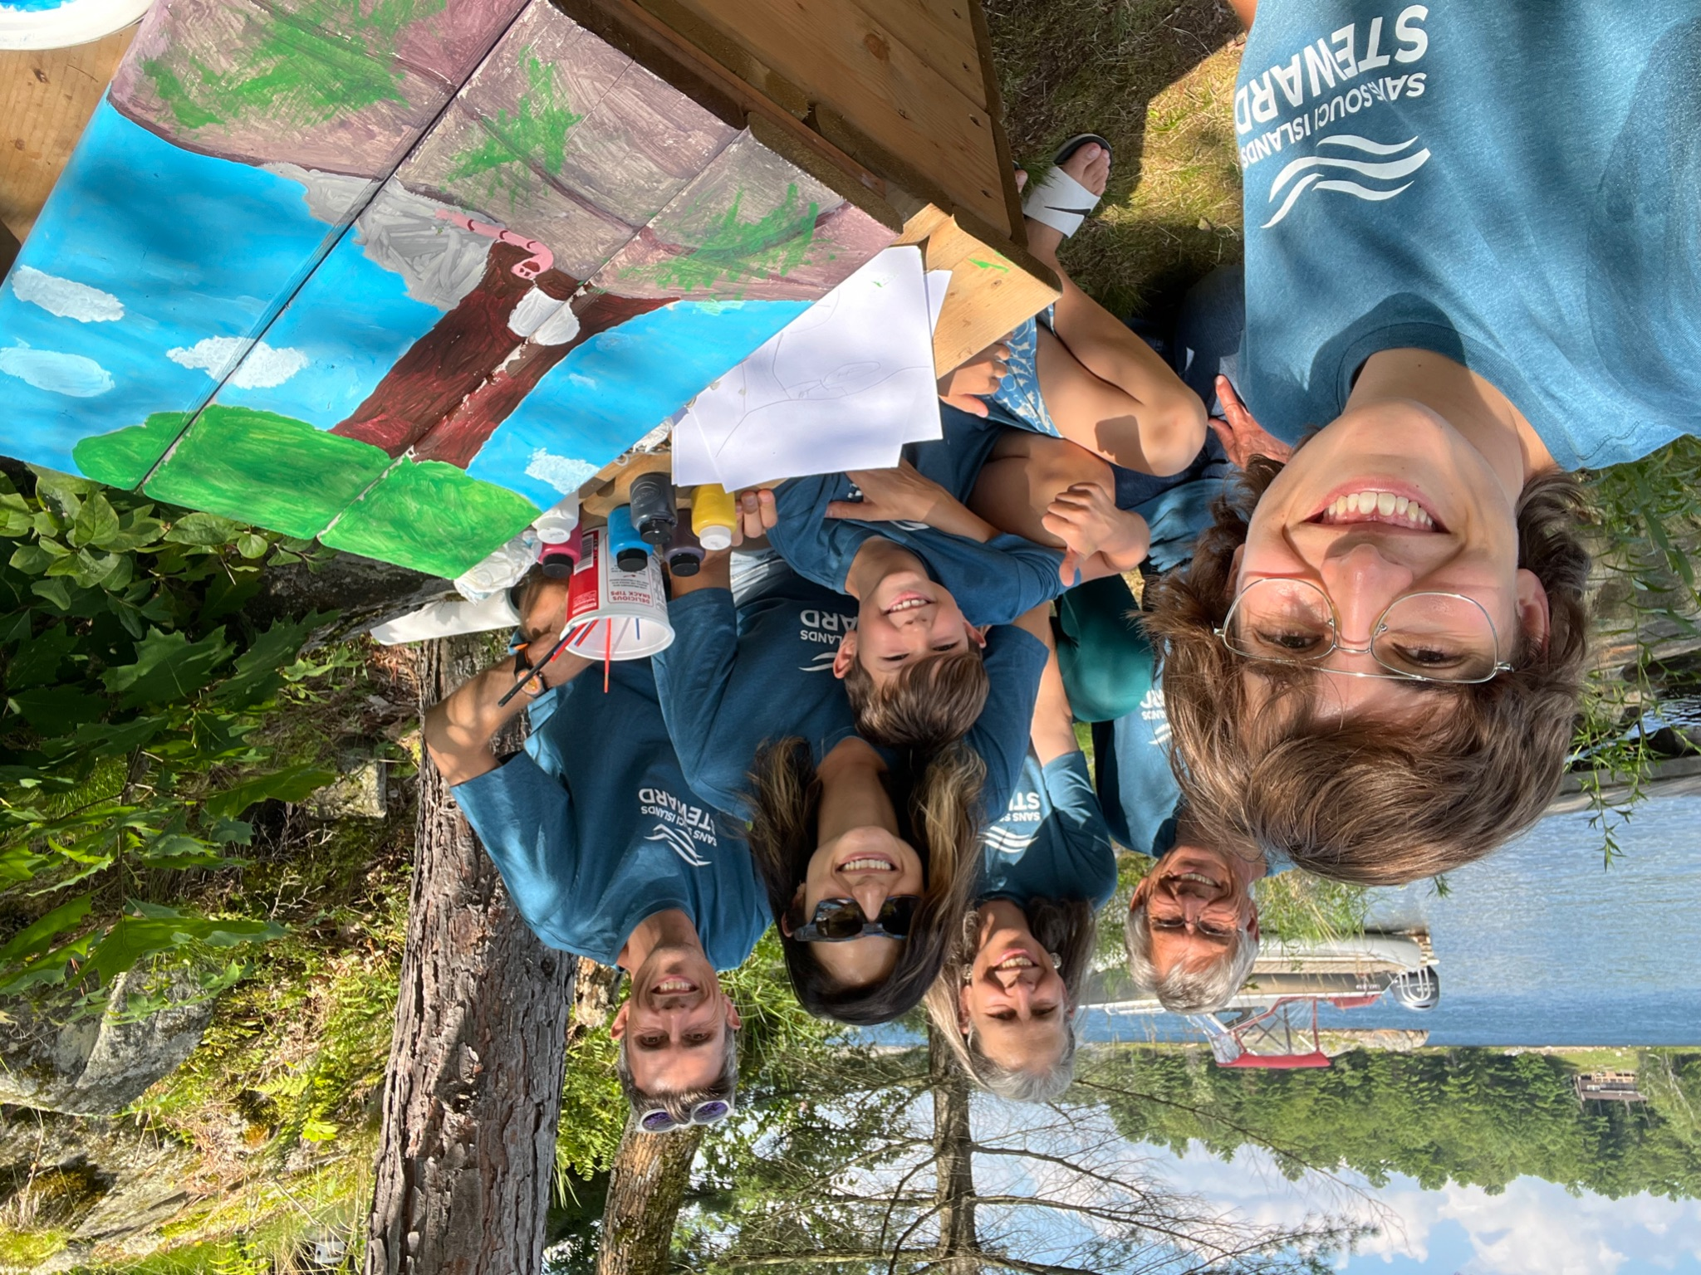
Steward Responsibilities
Stewards visit Pomeroy or Frying Pan at least once a summer and record what they see
Collect and record and litter
Gather together to meet other stewards
To find out more watch our new SSCA Stewards of the Bay video!

Slide 36
Georgian Bay Biosphere
Kids in the Biosphere
Nature discovery kits & education for kids
Contact Tory Cadotte to sign up and receive a kit
Bioblitz on the Moon Island Trail - August 10th @ 10am
GBB will be leading a Bioblitz for the SSCA on Moon Island
Please bring closed toe shoes, sunscreen and anything else you need for safe exploring!

Slide 37
Introducing … GBA’s Champion of the Bay Award!

Slide 38
Champion of the Bay Award
Purpose: To recognize and honor (volunteer) community members who actively steward the Bay in a way that promotes environmental wellbeing.
What can you do?
Nominate someone you know
This fall the SSCA will select our own Champion of the Bay to go on to the GBA level.

Slide 39
Thank you and Questions
If you are interested in getting involved with any of these initiatives please reach out!

Slide 40
ToA Update

Slide 41
GBA update Rupert Kindersley

Slide 42
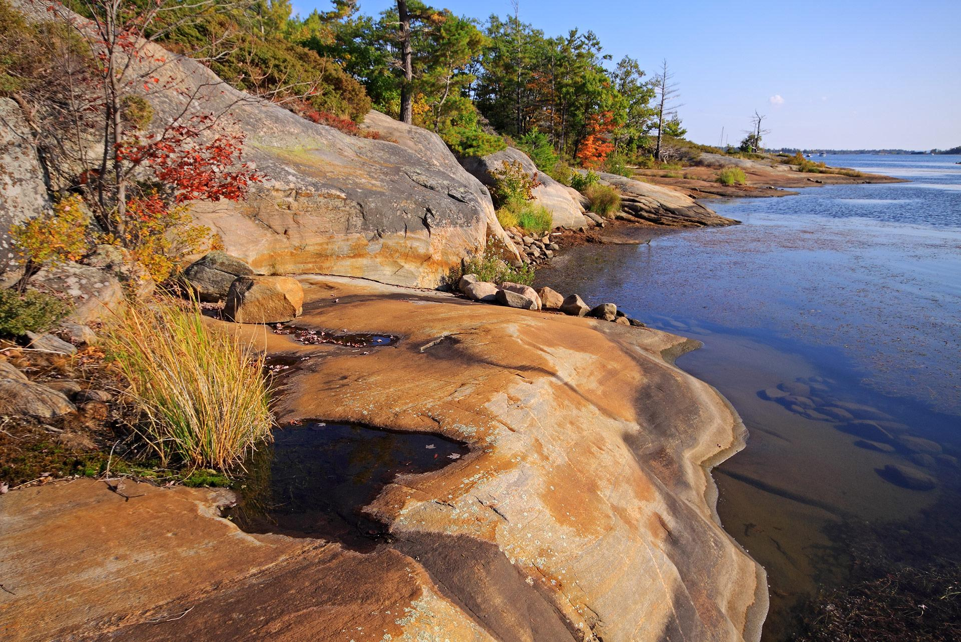
GBA Amplifies Your Voice
Founded 1916
Advocates on behalf of 18 associations
Represents ~30,000 individuals
Notes:
Since 1916, we have taken a leadership role, advocating to all levels of government and other stakeholders on behalf of 18 water-based communities on the eastern and northern shores of Georgian Bay, on a broad range of issues, to protect and preserve this precious and fragile freshwater ecosystem for generations to come. As your watchful eye on the Bay, GBA often identifies and addresses matters early on, before they become a problem.

Slide 43
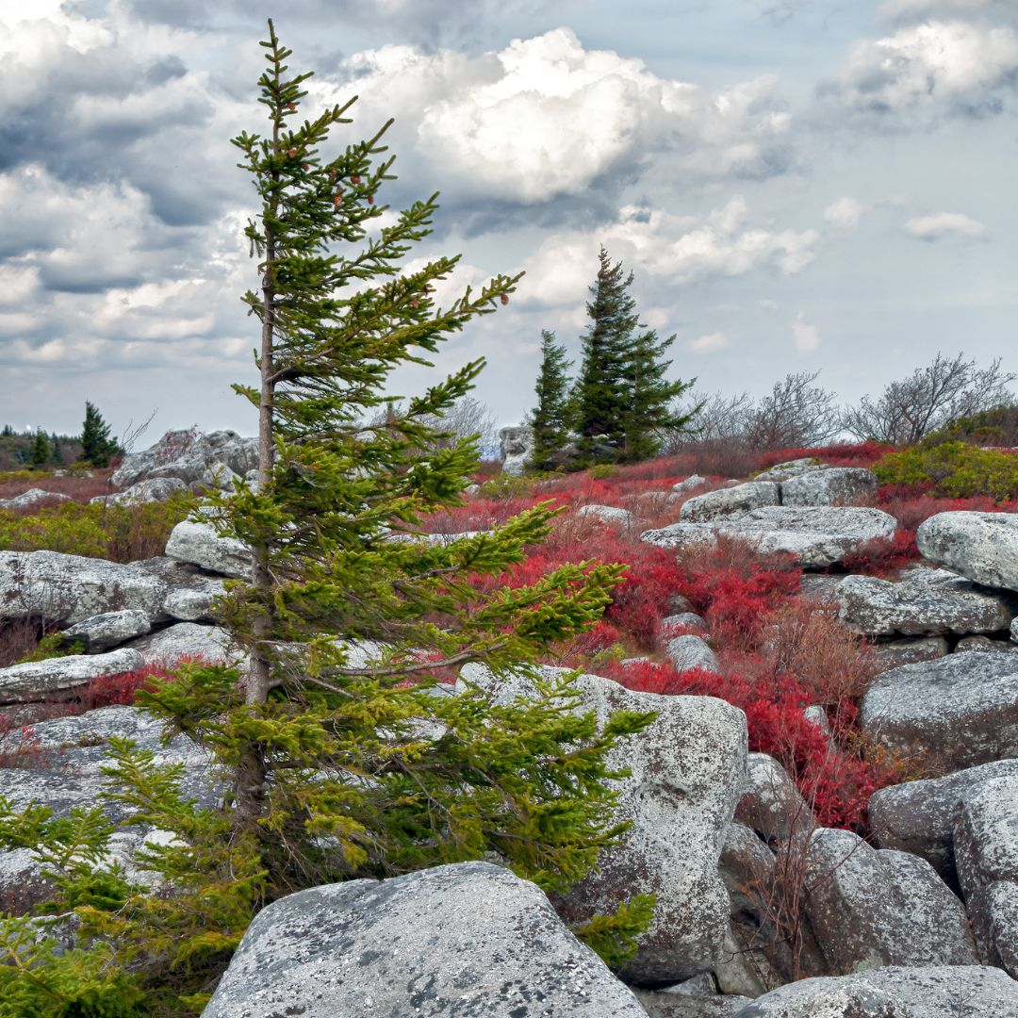
GBA Reaches Out to You
GBA UPDATE: 3 times/year
eUpdate: Monthly email
Presidents’ Letter

Slide 44
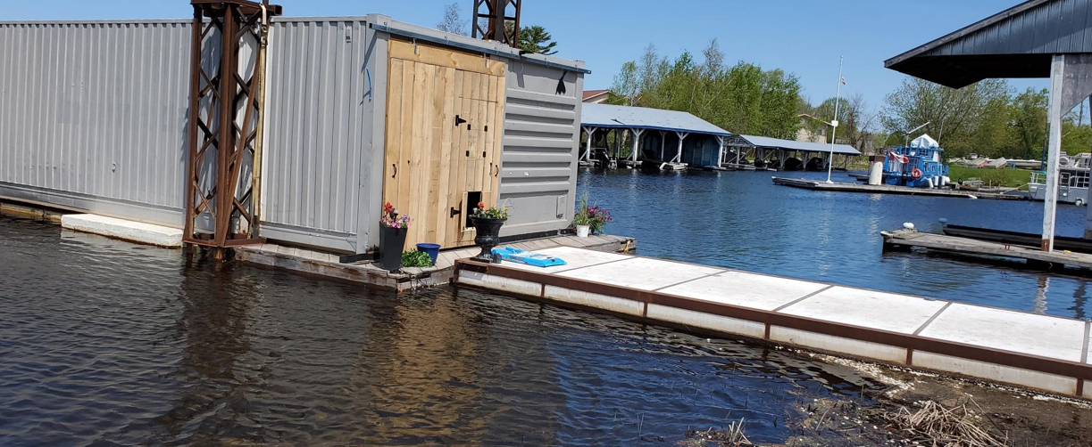
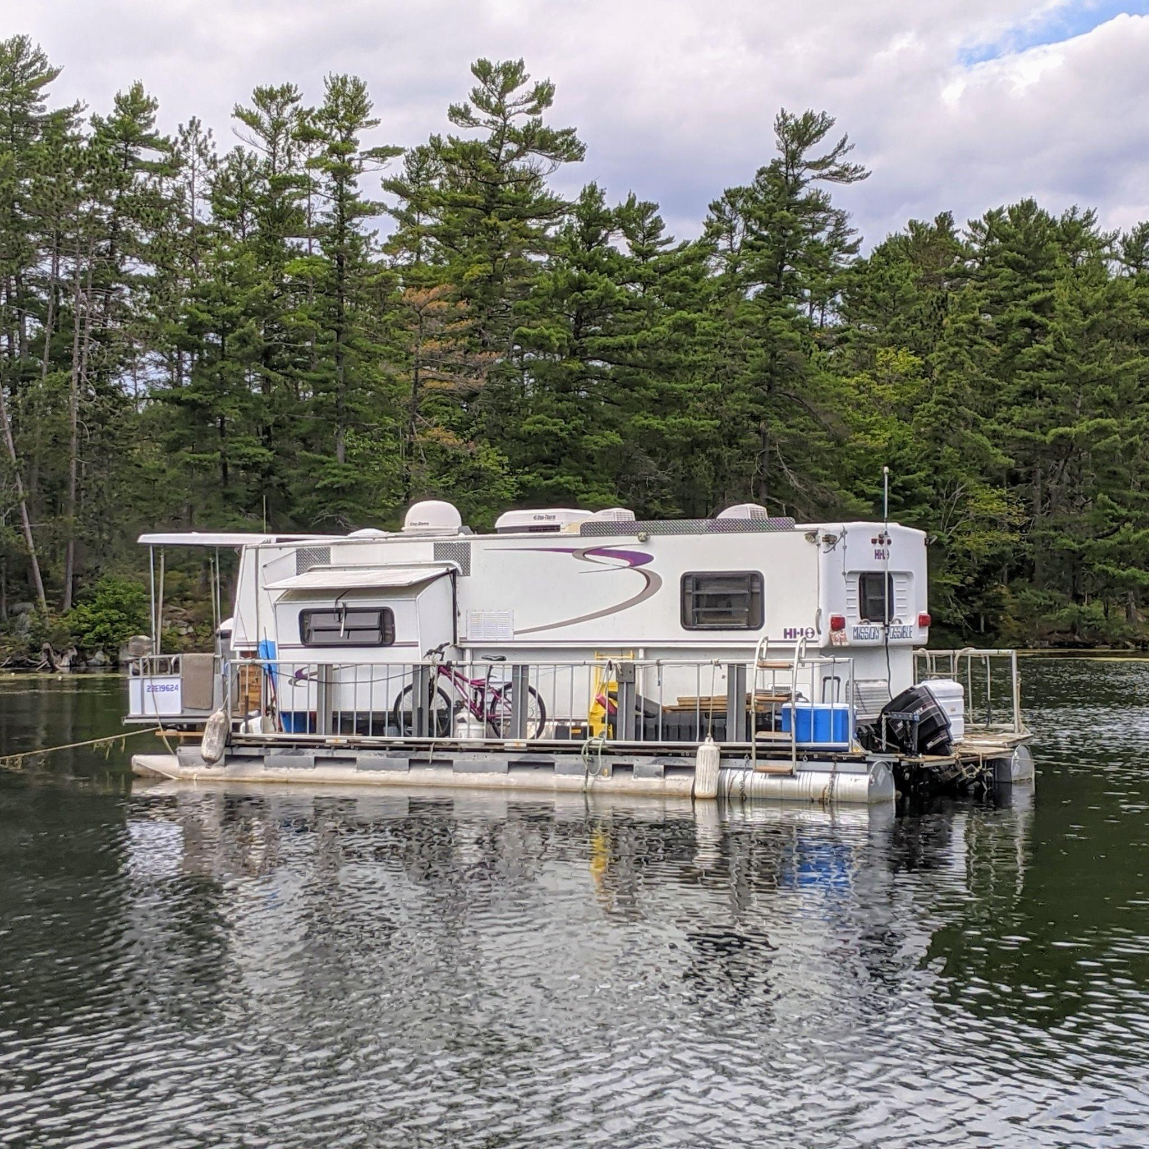
Floating Homes
Formed a strategy group
35+ Mayors and 5 MPs
Over 40 cottage associations
Support from MNRF
1000s of cottagers have weighed in on the issue
Transport Canada
Notes:
Floating Homes
Advocating to ensure floating homes are properly regulated to avoid environmental impacts and address safety concerns
Strategy group formed early 2022
Over the past several months this group has been very busy. Our freedom of information request to Transport Canada resulted in over 720 pages of information, in summary:
TC views their charter is to manage vessel safety and the definition of a vessel
TC does not view their role to manage where vessels travel or where they moor
TC repeatedly (within the 720 pages) referred to the MNRF 161/17 work as a good role model to follow for any other gov’t jurisdictions wishing to get involved in building and enforcing a regulatory framework
As a result, the coalition had to pivot and we have created a tri-level working group consisting of Parks Canada, MNRF, Severn Township, Georgian Bay Township and Tay Township (township members include planning departments, bylaw enforcement and as time permits mayors). At the first meeting April 9th, all parties presented their concerns and current status with respect to floating accommodations. Once the group solidifies, more information on the group and its actions will be included in the reporting to this committee, we feel we need to ensure that there are concrete executed plans before moving it to the public domain.
We were quite happy with the open and honest communication among the group. Float Homes not Vessel Coalition is simply acting as facilitators to this group. The next meeting of the tri-level working group will be held on May 9th. We have invited the OPP (they have agreed to attend) and Transport Canada (no word yet on their attendance).
Although we were disappointed in TC’s response, we feel this is the best course of action moving forward.
Why it matters to members:
With proper, enforceable regulations the addition of floating homes to the Bay can be socially and ecologically sustainable

Slide 45
Georgian Bay
Association
2024 Presentation to
Sans Souci & Copperhead Association
PROTECTING YOUR COAST
YOUR VOICE ON THE BAY

Slide 46
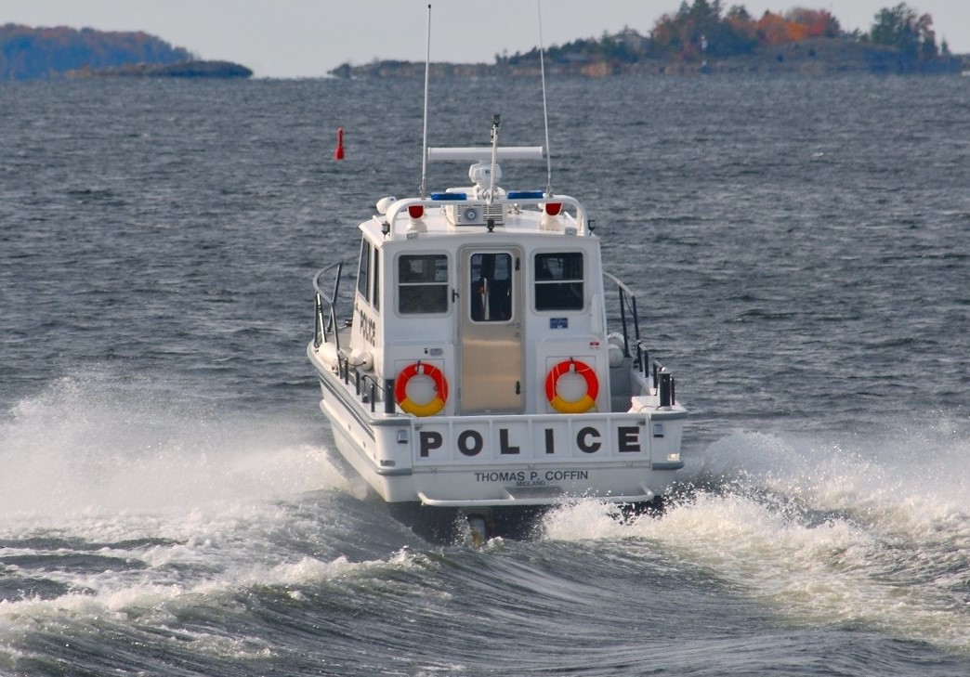
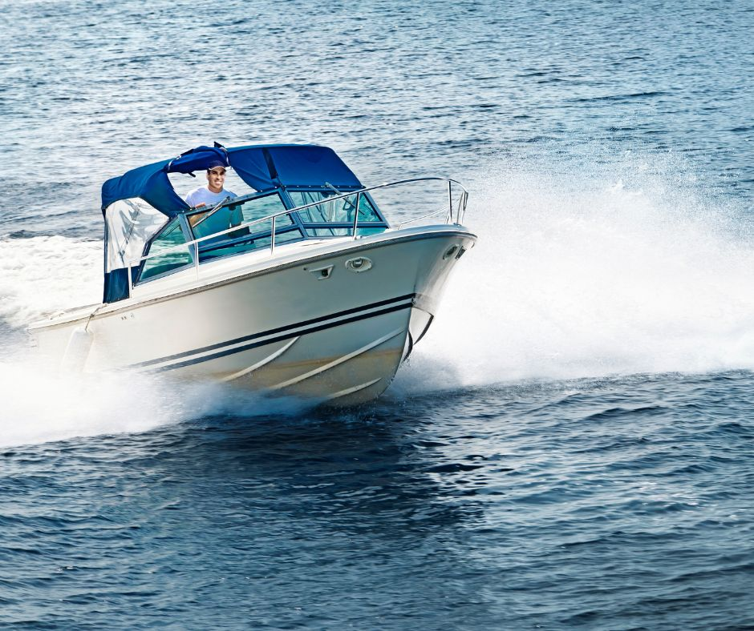
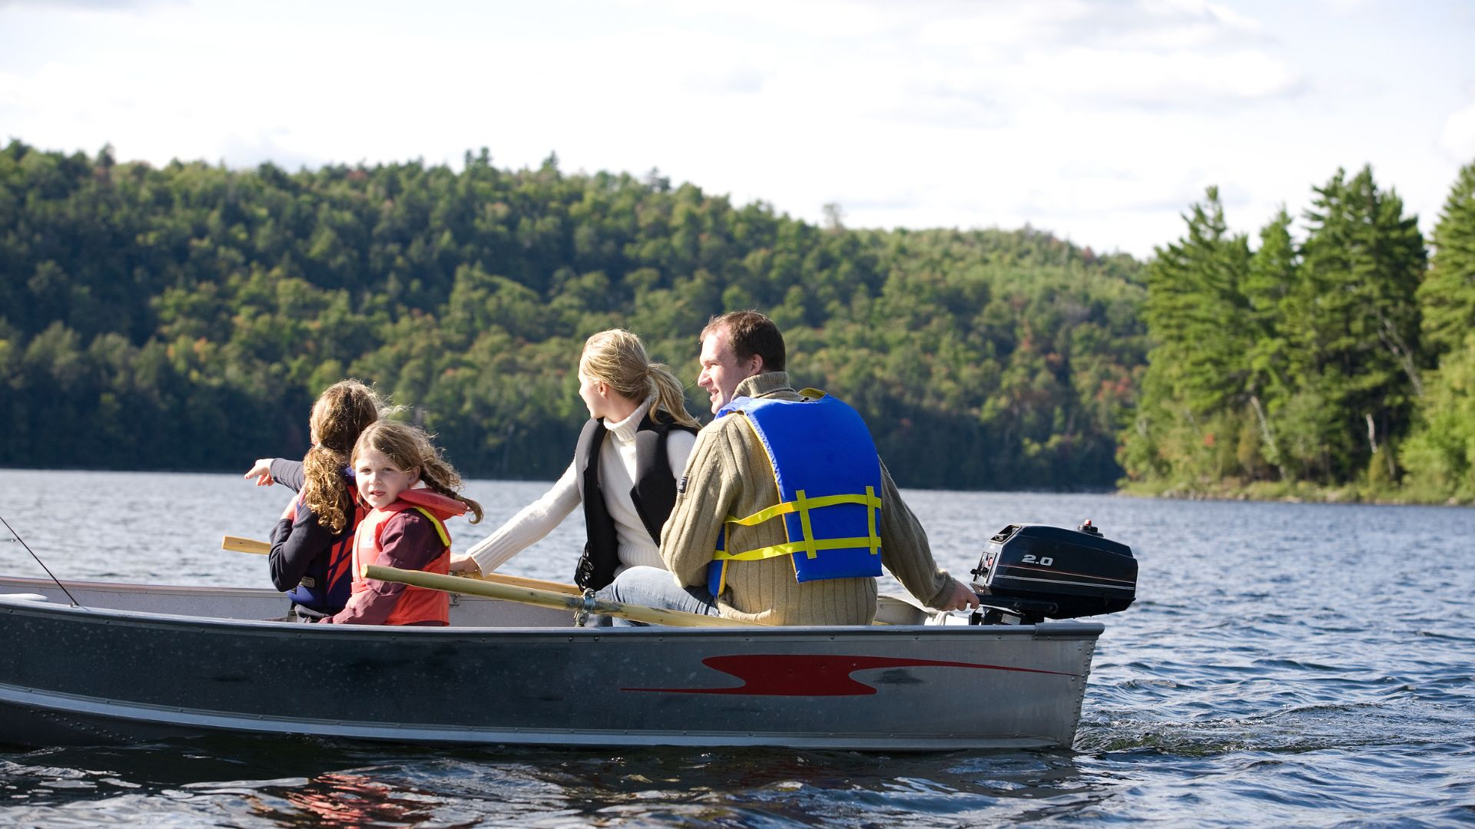
Fire - Boating & Safety
Fire
Boating
Fire danger ratings
Georgian Bay for Everyone
Restrictions
Boat Noise & Wakes
Safety information
Safety tips
Notes:
Fire
Informing members about MNRF and municipal fire danger ratings and restrictions throughout the fire season
Providing extensive fire safety information https://georgianbay.ca/boating/fire/
Ember the fire smart mascot!
Boating
Georgian Bay for Everyone – mutual respect between boaters and cottagers
Linking you to updated information about new regulations and making sure you have a chance to weigh in on:
Boat noise – Decibel Project
Safe Wakes Coalition - new strategy group GBA helped found
Why it matters to members:
▪ GBA provides these resources to protect your family and property
Other
- Lifejackets & PFDs
- what3words
- Georgian Bay for Everyone
- FireSmart
- Cold Water Awareness
- No Ice is Safe Ice
- eFlares
- Messaging from OPP, MNRF, TC, CCG and other partners

Slide 47
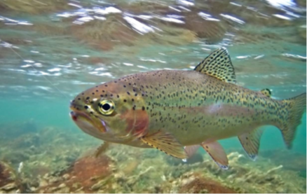
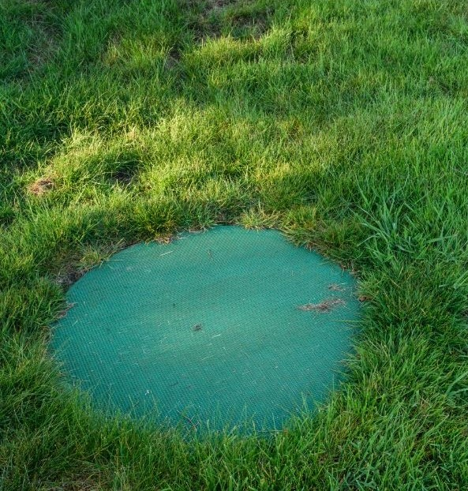
Water Quality – TCE Pumped Storage Project
Water Quality
TCE Pumped Storage Project
Cruise ships
Major development
Microfibres & dock foam
Environmental impacts
GLWQA & GLEN
Uncompetitive process
Notes:
Water Quality
Research project completed on cruise ship traffic on Georgian Bay to ensure wastewater etc. regulations are in place and being followed – advocacy on greywater regs; emergency response preparedness
Supporting legislation to keep plastics and micro-fibres out of our water
Legislation to require filters to be installed in new clothes washing machines
The Bill to ban dock foam for new docks and dock repairs was passed in May 2021 – now need to get the regulations in place
Why it matters to members
Keeping our waters free of pollutants is a key priority
TCE Pumped Storage Project
Energy storage proposal at Meaford
GBA started working with Save Georgian Bay (SGB) on this Project in Sept 2019 and we have been instrumental in persuading TCE to change the design to minimize the potential environmental impacts (the Project is so massive that it could impact water quality throughout the Bay) and, more recently, causing the Independent Electricity System Operator (IESO) and the ON Ministry of Energy (MoE) to delay their decision on the Project to July 31, 2024.
Our aim is to ensure that GBA members have full, complete and accurate information on the Project, its potential environmental impacts, and how it stacks up financially against alternative storage methods for Ontario taxpayers. There have been, and will continue to be, opportunities for GBA members and Georgian Bay communities to then make informed decisions on whether or not to submit comments to the Ontario government.
Department of Defence (DoD) site contamination – clean it up first before any construction
Deputations to municipalities
Independent Electricity System Operator (IESO) battery storage projects – almost 3,000 MW – more to come
competitive public tender should be required, as recommended by IESO. This process is usually required for all government contracts. See: https://georgianbay.ca/tc-energy/
Why it matters to members:
Preserving your water quality preserves your way of life on the Bay and everything that makes it special

Slide 48
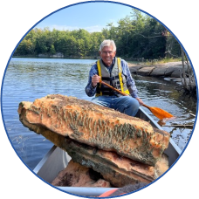
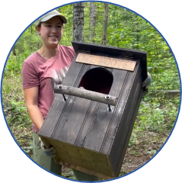
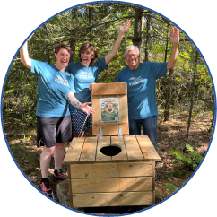
Champion of the Bay Award
Recognition of those who actively steward Georgian Bay in a manner that promotes environmental wellbeing
appreciate the contributions of committed community members - inspire more stewardship activities
https://georgianbay.ca/champion-of-the-bay-award/

Slide 49
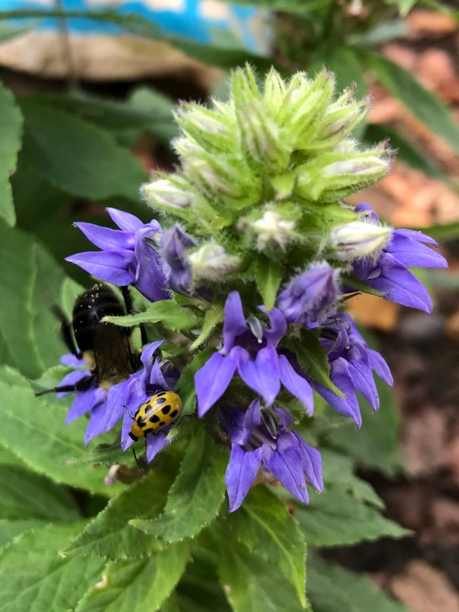
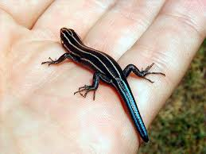
Coastal Protection - Lands and Forests
Coastal Protection
Lands and Forests
MPCP – GBB project
Phragmites Working Group
Vision 2050 project
Educate members
Septic System Guide
Work with other GB orgs
Notes:
Coastal Protection
MPCP – GBB project
Last delegation to TGB on June 3 – next steps dialogue/workshops
Working with GBB’s new Natural Asset Management Planning Project – many synergies - using MPCP research
Vision 2050 project
New project being launched this year
Identify a regional policy framework with the objective of preserving and protecting the unique eastern and northern coasts of the Bay, the Thirty Thousand Islands archipelago, and its waters through a comprehensive review of planning and conservation policies and structures on the coastline. The first stage of the project is to develop a white paper authored by recognized and highly credible professional planning and environmental experts to identify an inclusive process to create a suitable policy framework, and a directional view of the future of the coast. We have already met with many experts and those meetings helped to inform our plans for this project and the process to be followed. This process will include consultations with a range of stakeholders, including governments, Georgian Bay organizations, and First Nations.
Published a guide about septic systems in 2023 to help you reduce the risk of water quality issues around your cottage
Why it matters to members
GBA’s resource guides to empower members to make environmentally responsible choices for their properties
Responsible planning practices will ensure sustainable development and protect the coastal environment for generations

Slide 50
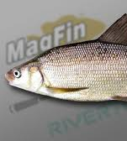
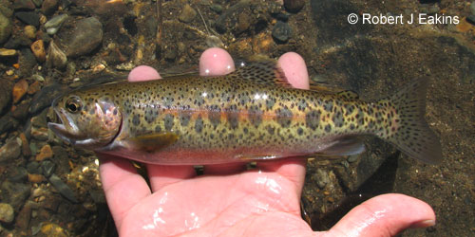
Other Current Priorities & Recent Activity
Advocacy – Activity
Aquaculture
Capital Gains Tax Increase
Open net pen industry
Bill 185
Government advocacy
Indigenous Education
Sustainable operations
Notes:
Capital Gains Tax Increase
Asked govt to mitigate the unintended consequences on those not in the wealthiest 0.13%
Transfer of cottages to the next generation
Need for tax planning – consult your professional advisors – FOCA has good reseources
Bill 185
Key issue for GB residents is proposed removal of public’s ability to appeal the adoption or amendment of Official Plans and Zoning By-Laws
GBA asked for these critical, long-standing rights to appeal local land use decisions to the Ontario Land Tribunal (OLT) to be maintained and protected.
Similar amendments were first included in Bill 23 in 2022 but were rightly removed from that Bill in response to public concern.
Worked with CELA
Indigenous Education
Member education – providing information on land use issues and treaties
Sharing traditional ecological knowledge (TEK)
Aquaculture
Advocating for 25 years to ensure the open net pen industry in the Bay isn’t expanded and environmental regulations remain robust
Industry has not expanded - only 5 commercial and 6 indigenous sites, but production has increased at these sites
Currently engaged with MNRF, MECP and DFO regarding new proposed 20-year licenses - detailed discussions - environmental safeguards significantly increased
Indigenous communities currently developing guidelines and protocols that may increase protections
Working with OAA and MNRF to get Lake Wolsey closed down - lower/warming water pose major risk for blue green algae outbreaks
Why it matters to members:
Protecting water quality from an industrial activity

Slide 51
Summary
GBA’s Vision: The preservation and protection of the Bay and its natural environment, ecosystems, and species to sustain this world-renowned biosphere and archipelago for future generations.
Environmental Protection
Member issues
Why it matters
Notes:
GBA Mandate
Our Vision: The preservation and protection of the Bay and its natural environment, ecosystems, and species to sustain this world-renowned biosphere and archipelago for future generations.
Our Mission: GBA's mission is to engage with all levels of government and like-minded organizations through education and advocacy to achieve our Vision.
Accomplishments
Over the years, we have made countless improvements to your coastal communities that have withstood the test of time, including:
⮚ The creation of the outside channel up the shore from Midland;
⮚ GBA played an important role in the creation of the Georgian Bay Land Trust, Georgian Bay Forever and the Township of the Archipelago; and
⮚ A significant role in: securing the UNESCO designation for the Georgian Bay Biosphere; and the creation of the Massasauga Provincial Park.
Environmental Protection & Member Issues
By staying up-to-date on all issues and concerns, maintaining current and active government contacts, and collaborating closely with our community association partners, the GBA is able to ensure careful stewardship of the greater Georgian Bay environment and address new and long term member issues.
GBA has 2 staff members (1 full and 1 part-time), 23 volunteer directors and an additional 32 non-board volunteers to man our 15 committees that deal with a wide range of issues (48 at last count and climbing!).
The 13 Committees are:
Aquaculture
Boating, Safety & Emergencies
Coastal Protection Advisory
Communications
Executive
Fisheries
First Nations Liaison
Floating Homes Strategy Group
Governance & Nominations
Guardians of the Bay
Lands & Forests
Membership
Water (Water Quality & Water Levels)
Vision 2050 – Fundraising
TCE Energy
Why it matters
All the Great Lakes including Georgian Bay face mounting threats ranging from climate change to industrial/farm pollution to unsustainable developments. GBA is your line of defense and source of information in addressing these threats.

Slide 52
Approval of SSCA Board 2023 Actions Glen Campbell, President
Motion to approve SSCA Board 2023 actions

Slide 53
Governance / Board of Directors Glen Campbell
Thank-you to our retiring directors
TOM DENUNE
DAN RESZCZYNSKY
Welcome to our new directors
TORY CADOTTE
ROB KENNEDY
MICHAEL REDDY
..and volunteers
BRENNAN LANE
RHONDA LENNOX

Slide 54
SSCA Board of Directors
` | Year Joined Board | Yrs | Current Role | Committee(s)
Eric Armour | 2016 | 8 | Vice-President | Communications, GBA Director, Membership
Glen Campbell | 2020 | 4 | President | Executive *
Jackie Campbell | 2022 | 2 | Director | Tennis Liaison
Tory Cadotte | 2023 | 1 | Director | Programs *
Katherine Denune | 2016 | 8 | Director | Environment *, GBA Director
Jacquie Green | 2021 | 3 | Director | Membership *
Kirsi Henry | 2022 | 2 | Director | Communications *
Rob Kennedy | 2024 | 0 | Director | Property *
Jackie Koza | 2019 | 5 | Director | Property
Michael Reddy | 2024 | 0 | Secretary | Executive
Walter Sloan | 2020 | 4 | Director | ICFC Liaison
Alan Stratton | 2016 | 8 | Treasurer | Executive, Finance *, GBA Director

Slide 55
Governance / Board of Directors Glen Campbell
Motion to approve
2024 Board of Directors

Slide 56
Wrap-up
Other business?
Motion to adjourn

